Slide 1

Please connect to the cluster while waiting for the session to begin…
Credit: XKCD

Slide 2
An Introduction to HPC December 2025

Slide 3

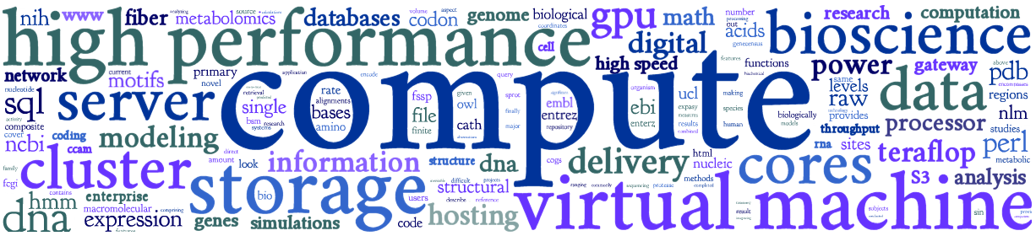
Outcomes of workshop
Overview of Crop Diversity HPC & compute resources
Connect to cluster and complete common tasks
Understand basics of job submissions with Slurm
Use bioconda package manager and containers
Know cluster etiquette & how to get further help
Get an overview of GPU resources

Slide 4
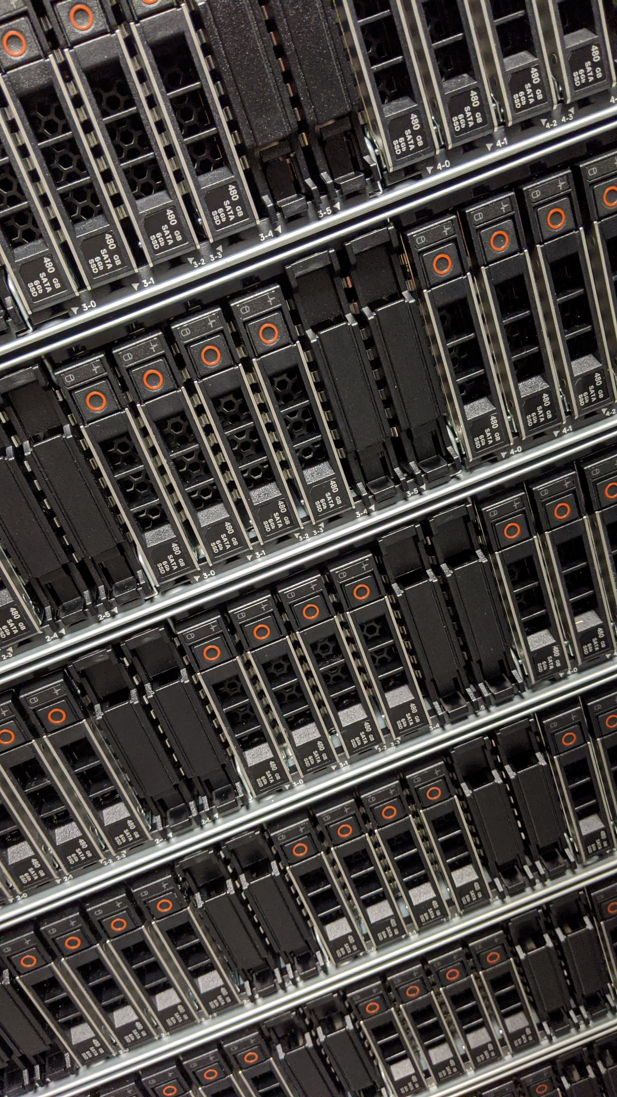





Crop Diversity HPC
Initially funded by the BBSRC
For use by:
JHI, NIAB, SRUC
RBGE, RBGK, NHM
10,000 CPU cores; 500,000 GPU cores
100-gigabit networking
8 PB of storage
4 PB of backup
700+ users

Slide 5









2023-24 HPC Upgrades
2019 kit additional (2023) and (2024)
1,844C/3,688T CPUs
49x 192GB, 3x 256GB, 2x 384GB
1x 1.5TB, 1x 2TB, 1x 3TB
3x Tesla V100 16/32GB
2x Quadro RTX 8000 48GB
1.7PB primary
1PB backup
25Gbps
2x virtual hosts
3,072C/6,144T CPUs + 1,152C/2,304T
32x 256GB, 14x 512GB, 18x 384GB
1x 1TB, 2x 2TB, 1x 4TB
36x Ampere A100 80GB
12x Lovelace L40S 48GB
5PB primary + 1.7PB
3PB backup + 1.3PB
128TB NVMe flash scratch + 40TB
100Gbps + more switches
2x virtual hosts
Compute:
Hi-mem:
GPUs:
Storage:
Networking:
VMware:
plus racks, cabling, UPS, power distribution, additional central IT backup etc…
Notes:
CPUs: 32C/64T means 32 cores and 64 hyperthreads

Slide 6
HPC overview
High-performance computing (HPC) is the use of supercomputers and parallel computing techniques to solve complex computational problems
user’s desktop
connect to cluster (SSH)
shared
storage
head node
n1
n2
n3
n4
worker/child/compute nodes
all nodes are running the Linux distribution known as Debian Linux (version 12.x)
Notes:
Supercomputers vs clusters vs PCs

Slide 7
https://help.cropdiversity.ac.uk/

